Slide 1
DEVICES AND CIRCUITS
UNIT 1
TOPIC:Rectifier

Slide 2
Rectifier
Many electronic circuits use DC voltage for operation.
We can easily convert AC voltage or current into DC voltage or current by using a device known as a p-n junction diode.
A p-n junction diode allows electric current to flow in forward bias condition and blocks the current in reverse bias condition.
Simply, a diode allows electric current to flow in one direction only. This unique property of diode allows it to act as a rectifier.

Slide 3
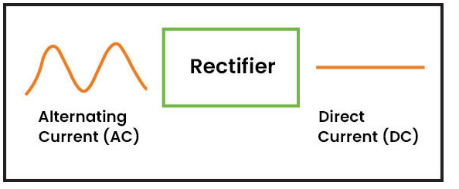
What is Rectifier?
A rectifier is an electronic device that converts an alternating current into a direct current by using one or more P-N junction diodes.
A diode behaves as a one-way valve that allows current to flow in a single direction. This process is known as rectification.
A rectifier can take the shape of several physical forms such as solid-state diodes, vacuum tube diodes, mercury-arc valves, silicon-controlled rectifiers, and various other silicon-based semiconductors switches.

Slide 4
Different Types of Rectifier
Rectifiers are mainly classified into two types as:
Uncontrolled Rectifier
Controlled Rectifier

Slide 5
Uncontrolled Rectifiers
The type of rectifier whose voltage cannot be controlled is known as an uncontrolled rectifier.
Uncontrolled rectifiers are further divided as follows:
Half Wave Rectifier
Full Wave Rectifier
The type of rectifier that converts only the half cycle of the alternating current into the direct current is known as a half-wave rectifier.
Likewise, a full-wave rectifier converts both positive and negative half cycles of the AC.
An example of this is a bridge rectifier. A bridge rectifier uses 4 diodes that are connected in the form of a Wheatstone bridge.

Slide 6
Controlled Rectifiers
A type of rectifier whose voltage can be varied is known as the controlled rectifier.
We use SCRs, MOSFETs and IGBTs to make an uncontrolled rectifier a controlled one.
These rectifiers are preferred over their uncontrolled counterparts.
There are two types of controlled rectifiers, and they are Half Wave Controlled Rectifier and Full Wave Controlled Rectifier.
Half-wave controlled rectifier has the same design as the half-wave uncontrolled rectifier except we replace the diode with an SCR.

Slide 7
What Are Some Applications of Rectifiers?
Some common applications of rectifiers are:
Rectifiers are used in electric welding to provide polarized voltage.
Half-wave rectifiers are used as a mosquito repellent.
Half-wave rectifiers are used as a signal peak detector in AM radio.
Rectifiers are used in modulation, demodulation and voltage multipliers.

Slide 8
Half Wave Rectifier
Half-wave rectifiers transform AC voltage to DC voltage.
A half wave rectifier circuit uses only one diode for the transformation.
A half wave rectifier is defined as a type of rectifier that allows only one-half cycle of an AC voltage waveform to pass while blocking the other half cycle.

Slide 9
Half Wave Rectifier Circuit
A half-wave rectifier is the simplest form of the rectifier and requires only one diode for the construction of a halfwave rectifier circuit.
A halfwave rectifier circuit consists of three main components as follows:
A diode
A transformer
A resistive load

Slide 10
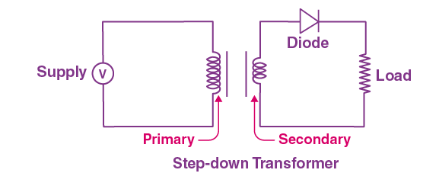
Half-wave rectifier diagram:

Slide 11
Working of Half Wave Rectifier
In this section, let us understand how a half-wave rectifier transforms AC into DC.
A high AC voltage is applied to the primary side of the step-down transformer. The obtained secondary low voltage is applied to the diode.
The diode is forward biased during the positive half cycle of the AC voltage and reverse biased during the negative half cycle.

Slide 12
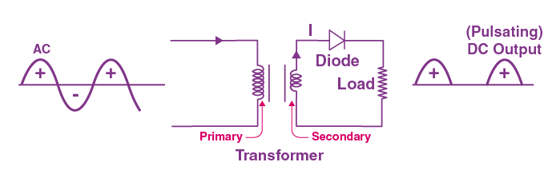
Cont….
The final output voltage waveform is as shown in the figure below:

Slide 13
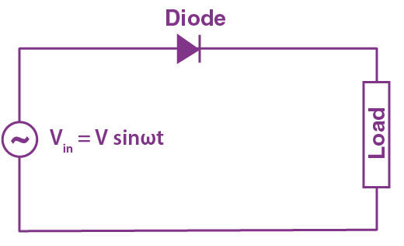
For better understanding, let us simplify the half-wave circuit by replacing the secondary transformer coils with a voltage source as shown below:

Slide 14
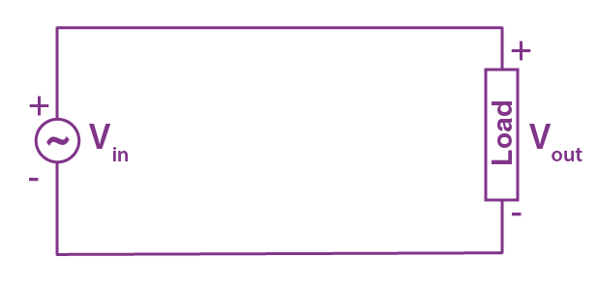
For the positive half cycle of the AC source voltage, the circuit effectively becomes as shown below in the diagram:

Slide 15
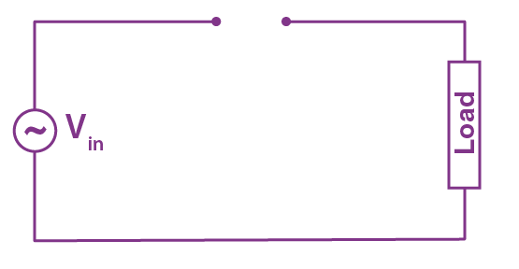
When the diode is forward biased, it acts as a closed switch. But, during the negative half cycle of the AC source voltage, the equivalent circuit becomes as shown in the figure below

Slide 16
When a diode is reverse biased, it acts as an open switch. Since no current can flow to the load, the output voltage is equal to zero.

Slide 17
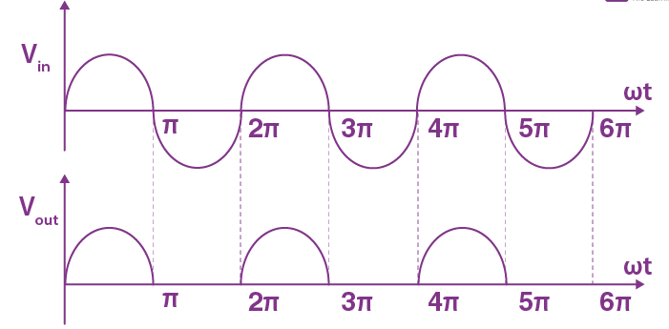
Half Wave Rectifier Waveform
The halfwave rectifier waveform before and after rectification is shown below in the figure.

Slide 18
Half Wave Rectifier Capacitor Filter
The output waveform of a halfwave rectifier is a pulsating DC waveform.
Filters in halfwave rectifiers are used to transform the pulsating waveform into constant DC waveforms.
A capacitor or an inductor can be used as a filter.
The circuit diagram below shows how a capacitive filter is used with halfwave rectifier to smoothen out a pulsating DC waveform into a constant DC waveform.

Slide 19
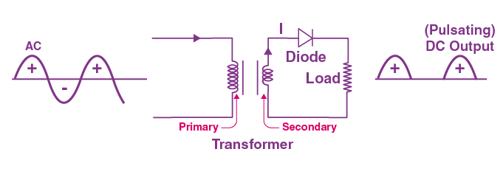

Slide 20

Half Wave Rectifier Formula
Ripple Factor of Half Wave Rectifier
Ripple factor determines how well a halfwave rectifier can convert AC voltage to DC voltage.
Ripple factor can be quantified using the following formula:
The ripple factor of a halfwave rectifier is 1.21.

Slide 21

Efficiency of Halfwave Rectifier
The efficiency of a halfwave rectifier is the ratio of output DC power to the input AC power.
The efficiency formula for halfwave rectifier is given as follows;

Slide 22

RMS value of Half Wave Rectifier
The RMS value of the load current for a half-wave rectifier is given by the formula:

Slide 23

Form factor of a Half wave Rectifier
The form factor is the ratio between RMS value and average value and is given by the formula:

Slide 24
Applications of Half Wave Rectifier
Here are a few common applications of half wave rectifiers:
They are used for signal demodulation purpose
They are used for rectification applications
They are used for signal peak applications

Slide 25
Disadvantages of Half Wave Rectifier
Power loss
Low output voltage
The output contains a lot of ripples

Slide 26
Questions
Q1. What is a halfwave rectifier?
The rectifier circuit that converts alternating current into the direct current is known as a halfwave rectifier circuit. The half-wave rectifier passes only one half of the input sine wave and rejects the other half.
Q2. Where is a halfwave rectifier used?
A half-wave rectifier is used in firing circuits and pulse generating circuits. Halfwave rectifiers are used along with step up and step down transformers to achieve the desired voltage.
Q3. How does a half-wave rectifier work?
Half wave rectifier circuit uses a PN junction to convert the supplied AC into DC. In a half-wave rectifier circuit, the load resistance is connected in series with the PN junction diode.
Q4. Is the half-wave rectifier better or the full-wave rectifier?
Full-wave rectifiers are more efficient than half-wave rectifiers. A full-wave rectifier passes twice as many waves as a half-wave rectifier. Hence, more of the input is transferred to the load.
Q5. What is the use of a filter in a half-wave rectifier?
The filter in a half-wave rectifier is used to smoothen the pulsating fluctuating DC component.

Slide 27
Full Wave Rectifier
Electric circuits that convert AC to DC are known as rectifiers.
Rectifiers are classified into two types as Half Wave Rectifiers and Full Wave Rectifiers.
Significant power is lost while using a half-wave rectifier and is not feasible for applications that need a smooth and steady supply.
For a more smooth and steady supply, we use the full wave rectifiers.

Slide 28
Defining Full Wave Rectifiers
A full wave rectifier is defined as a rectifier that converts the complete cycle of alternating current into pulsating DC.
Unlike halfwave rectifiers that utilize only the halfwave of the input AC cycle, full wave rectifiers utilize the full cycle. The lower efficiency of the half wave rectifier can be overcome by the full wave rectifier.

Slide 29
Full Wave Rectifier Circuit
The circuit of the full wave rectifier can be constructed in two ways.
The first method uses a centre tapped transformer and two diodes. This arrangement is known as a centre tapped full wave rectifier.
The second method uses a standard transformer with four diodes arranged as a bridge. This is known as a bridge rectifier.

Slide 30
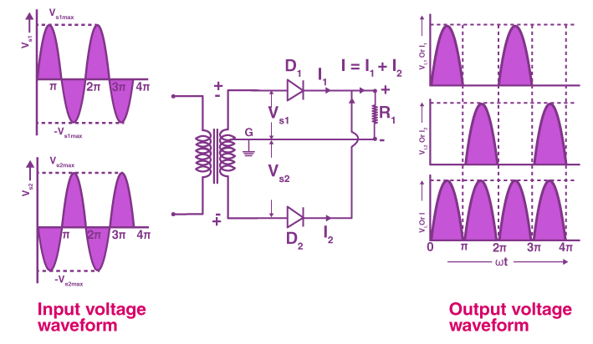

Slide 31
The circuit of the full wave rectifier consists of a step-down transformer and two diodes that are connected and centre tapped.
The output voltage is obtained across the connected load resistor.

Slide 32
Working of Full Wave Rectifier
The input AC supplied to the full wave rectifier is very high. The step-down transformer in the rectifier circuit converts the high voltage AC into low voltage AC.
The anode of the centre tapped diodes is connected to the transformer’s secondary winding and connected to the load resistor.
During the positive half cycle of the alternating current, the top half of the secondary winding becomes positive while the second half of the secondary winding becomes negative.
During the positive half cycle, diode D₁ is forward biased as it is connected to the top of the secondary winding while diode D₂ is reverse biased as it is connected to the bottom of the secondary winding. Due to this, diode D₁ will conduct acting as a short circuit and D₂ will not conduct acting as an open circuit.
During the negative half cycle, the diode D₁ is reverse biased and the diode D₂ is forward biased because the top half of the secondary circuit becomes negative and the bottom half of the circuit becomes positive. Thus in a full wave rectifiers, DC voltage is obtained for both positive and negative half cycle.

Slide 33
Full Wave Rectifier Formula
Peak Inverse Voltage
Peak inverse voltage is the maximum voltage a diode can withstand in the reverse-biased direction before breakdown. The peak inverse voltage of the full-wave rectifier is double that of a half-wave rectifier. The PIV across D₁ and D₂ is 2V_{max}.

Slide 34

DC Output Voltage
The following formula gives the average value of the DC output voltage:

Slide 35

RMS Value of Current
The RMS value of the current can be calculated using the following formula:

Slide 36

Form Factor
The form factor of the full wave rectifier is calculated using the formula:

Slide 37

Peak Factor
The following formula gives the peak factor of the full wave rectifier:

Slide 38

Rectification Efficiency
The rectification efficiency of the full-wave rectifier can be obtained using the following formula:
The efficiency of the full wave rectifiers is 81.2%.

Slide 39
Advantages of Full Wave Rectifier
The rectification efficiency of full wave rectifiers is double that of half wave rectifiers. The efficiency of half wave rectifiers is 40.6% while the rectification efficiency of full wave rectifiers is 81.2%.
The ripple factor in full wave rectifiers is low hence a simple filter is required. The value of ripple factor in full wave rectifier is 0.482 while in half wave rectifier it is about 1.21.
The output voltage and the output power obtained in full wave rectifiers are higher than that obtained using half wave rectifiers.
The only disadvantage of the full wave rectifier is that they need more circuit elements than the half wave rectifier which makes, making it costlier.

